Slide 1

Twitter Bot Analysis using Machine Learning
-Akshay Hazare
-Gaurang Gatlewar
-Shyam Nair

Slide 2
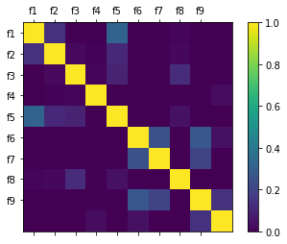
Overview of the Problem
TWITTER is a popular online social networking and micro blogging tool, which was released in 2006. Remarkable simplicity is its distinctive feature. Its community interacts via publishing text - based posts, known as tweets. These bots randomly add users as their friends, expecting a few users to follow back.
1 In this way, spam tweets posted by bots display on users’ homepages. Enticed by the appealing text content, some users may click on links and get redirected to spam or malicious sites.
2 If human users are surrounded by malicious bots and spam tweets, their twittering experience deteriorates, and eventually the whole Twitter community will be hurt. The objective of this Project is to characterize the automation feature of Twitter accounts, and to classify them into two categories, human and bot.
Correlation Matrix of all the Features

Slide 3
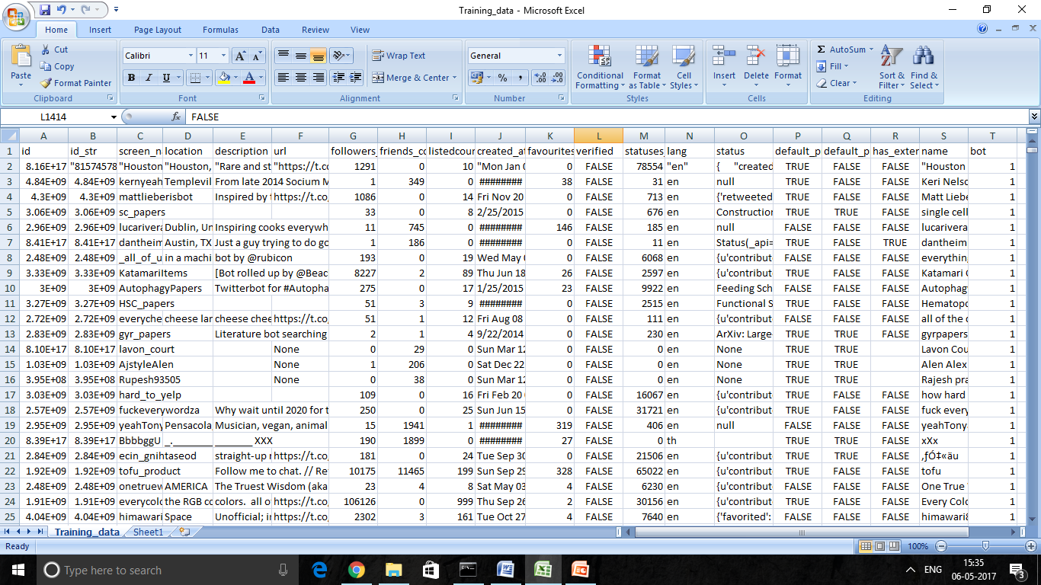
Overview of Dataset
In this project, we first created a dataset which consists of around 2800 twitter profiles which included both bots and human profiles.
This dataset consists of attributes like screen_name, description, verified etc. These attributes were extracted using Twitter APIs.

Slide 4
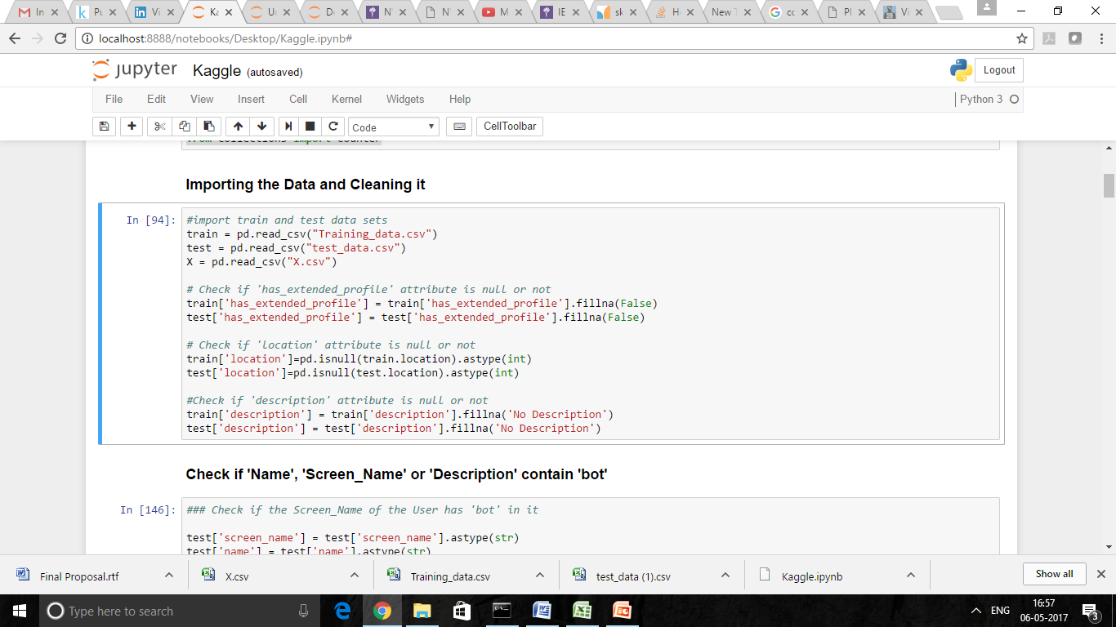
Cleaning and Analyzing the Data set
1.Check if there are any missing values in the dataset and fill them with appropriately
2.Replace all the ‘True’ and ‘False’ values with 1s and 0s respectively.
3.Split the dataset into training set and testing set
4.Standardizing the data.

Slide 5
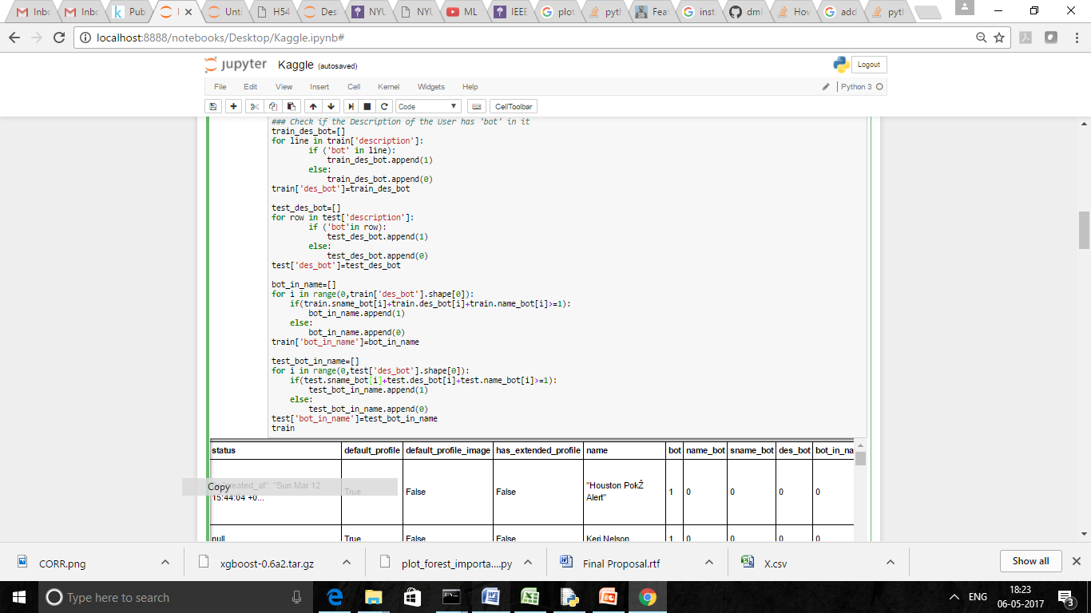
Analyze the Data set
Of all the 19 attributes, there were some attributes from which we could easily classify whether the profile is a bot or not. Those attributes were : Verified, default_Image, has_extended_profile etc.
Then we estimated the impact of each attribute and decided which attribute to use of all the given attributes.
Still the accuracy was not to the mark and we had to consider more attributes in order to increase the accuracy. So, we further analyzed more attributes such as screen_name, description and name and found if the keyword ‘bot’ was mentioned in them. If yes, then then its more likely to be classified as a Bot profile.

Slide 6

Models Used for Classification
Random Forest Classifier
Gradient Boost Classifier
Decision Tree Classifier
SVM
Ada Boost Classifier
The confusion and Accuracy score is with respect to our best Prediction on Kaggle.

Slide 7
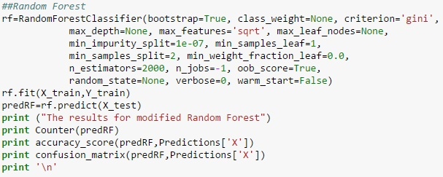
1. Random Forest
Description: Random forests or random decision forests are an ensemble learning method for classification, regression and other tasks, that operate by constructing a multitude of decision trees at training time and outputting the class that is the mode of the classes (classification) or mean prediction (regression) of the individual trees. Random decision forests correct for decision trees' habit of over fitting to their training set.
Cross Validation Score : 0.9002
Confusion Matrix : [297 7]
[2 269]
Accuracy : 98.43%

Slide 8
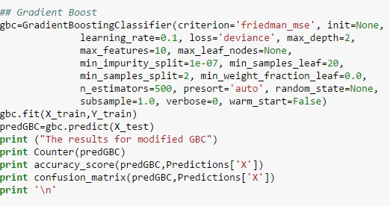
2. Gradient Boosting Classifier
Description: Gradient Boosting Classifier produces a prediction model in the form of an ensemble of weak prediction models, typically decision trees. It builds the model in a stage-wise fashion like other boosting methods do, and it generalizes them by allowing optimization of an arbitrary differentiable loss function.
Cross Validation Score: 0.9016
Confusion Matrix: [298 7]
[1 269]
Accuracy: 98.6%

Slide 9
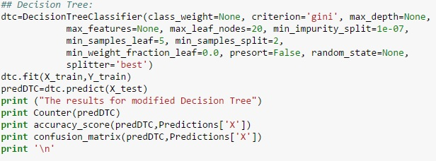
3.Decision Tree Classifier
Description: Decision tree learning uses a decision tree as a predictive model which maps observations about an item (represented in the branches) to conclusions about the item's target value (represented in the leaves). It is one of the predictive modelling approaches used in statistics, data mining and machine learning. Tree models where the target variable can take a finite set of values are called classification trees; in these tree structures, leaves represent class labels and branches represent conjunctions of features that lead to those class labels. Decision trees where the target variable can take continuous values (typically real numbers) are called regression trees.
Cross Validation Score: 0.8723
Confusion Matrix: [284 10]
[15 266]
Accuracy : 95.65%

Slide 10
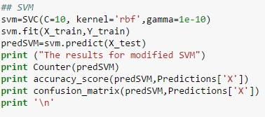
4. Support Vector Machine
Description: In machine learning, support vector machines (SVMs, also support vector networks) are supervised learning models with associated learning algorithms that analyze data used for classification and regression analysis. Given a set of training examples, each marked as belonging to one or the other of two categories, an SVM training algorithm builds a model that assigns new examples to one category or the other, making it a non-probabilistic binary linear classifier. An SVM model is a representation of the examples as points in space, mapped so that the examples of the separate categories are divided by a clear gap that is as wide as possible. New examples are then mapped into that same space and predicted to belong to a category based on which side of the gap they fall.
Cross Validation Score : 0.7271
Confusion Matrix: [215 7]
[84 269]
Accuracy : 84.17%

Slide 11
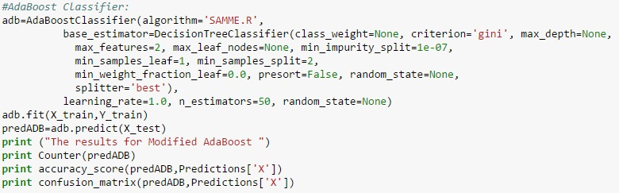
5. Adaptive Boosting Classifier
Description: It can be used in conjunction with many other types of learning algorithms to improve their performance. The output of the other learning algorithms ('weak learners') is combined into a weighted sum that represents the final output of the boosted classifier. Ada Boost is adaptive in the sense that subsequent weak learners are tweaked in favour of those instances misclassified by previous classifiers. Ada Boost is sensitive to noisy data and outliers. In some problems it can be less susceptible to the over fitting problem than other learning algorithms. The individual learners can be weak, but as long as the performance of each one is slightly better than random guessing (e.g., their error rate is smaller than 0.5 for binary classification), the final model can be proven to converge to a strong learner.
Cross Validation Score: 0.8863
Confusion Matrix: [294 3]
[5 273]
Accuracy : 98.6%

Slide 12
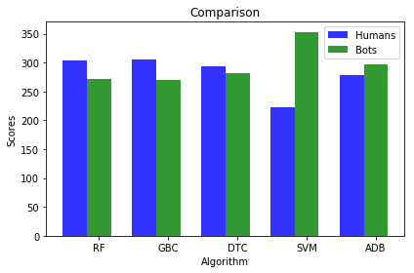
Comparison

Slide 13
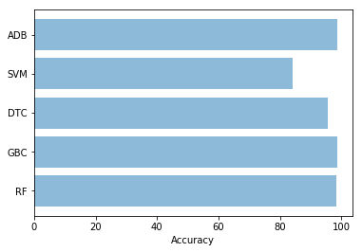
Comparison

Slide 14
Conclusion
Based on the cross validation score of all the models, we choose Gradient Boosting Classifier because it provides a maximum cross validation score of 0.9016
Algorithms | Cross Val Score
Random Forest Classifier | 0.9002
Gradient Boosting Classifier | 0.9016
Decision Tree Classifier | 0.8723
Support Vector Machine | 0.7271
Adaptive Boosting Classifier | 0.8863

Slide 15
Future Work
There are other improvements possible which have currently not been implemented to improve the prediction of the code. Currently only limited number of attributes have been used for classification. Further few more attributes can be used to improve the process as follows:
1. Status count rate can be used for prediction.
2. NLP can be performed on the text fields like description, statuses, etc.
3. NLP on description
4. Larger amount of Data with greater variation can be used to train the model.
5. Syntax and sentiment analysis can be performed.
6. Behaviour Analysis can be used to determine bot profiles.

Slide 16
Thank You!

